Slide 1
eHEALTH: INTERNATIONAL INITIATIVES, STRUCTURES AND TRENDS
F. Lievens^{1, 2}, M. Jordanova^{3, 4}
¹Med-e-Tel International Coordinator, Belgium medetel@skynet.be
² Board Member and Treasurer, International Society for Telemedicine & eHealth, Switzerland, treasurer@isft.net
³Med-e-Tel, Coordinator Educational Program
⁴ Institute of Psychology, Bulgarian Academy of sciences, Sofia, Bulgaria mjordan@bas.bg

Slide 2
Scope
The ultimate recipiendary of eHealth/Telemedicine is the Patient/Citizen via the Healthcare Professionals
Telecommunication and Information Technology (IT) are the tools to provide service to these recipiendaries
Welcome to
”MODERN COMMUNICATION HEALTH ENVIRONMENT”

Slide 3
The Global Challenge
To make all the different players to coordinate their skills and efforts to achieve an optimal development within the health environment using modern communication systems
Coordination
Science
Education
Policy making
Medical Devices & Pharma
Telecommuni-cation
IT
Services
Beneficiaries
Healthcare World
The Patient
The Citizen

Slide 4
Social and Political Environment
eHealth calls upon several components of the community
It therefore involves an important input at political level:
Health
Communication and Technology
Education
Industry
It is all part of eGovernment - National & International
Communication and cooperation between all Ministries and Parastatals is essential
Necessity of creating in all countries eHealth Coordinating Standing Committees

Slide 5
Social and Political Drivers
Constant development of medical science and technology
Rising public expectations - need for improved access for all and for high quality of services, reduction of disease burden and its impact on citizens and governments
Aging population
Development and accessibility to primary care
Paradigm shifts towards prevention
Cost pressure on healthcare systems
Mobility of citizens
Global access and competition
…

Slide 6
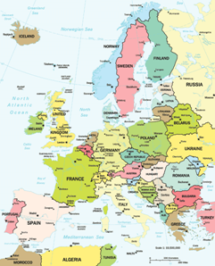
Europe
Area - world's second-smallest continent ~ 10,390,000 km² or 2.0% of the Earth's surface
Population - the third-largest continent (Asia and Africa are larger) with a population of ~ 11% of the world's population
The European Union, comprising 25 member states, is the largest political and economic entity covering the European continent
Another map

Slide 7
eHealth in Europe
Becoming 3rd industrial pillar of health sector (€11 bn in 2004, €50 bn in 2010)
Up to 5% of the total health budget ~2010
eHealth sector is:
Regulated but fragmented
Limited competition and conservative tendencies
Many SMEs
Based on two fundamental principles:
Subsidized
Free movement
3 key objectives:
European eHealth area
Free patient mobility
Empowerment of citizens

Slide 8
Supporting eHealth
EC uses four types of instruments:
Financial
Administrative - e-Europe 2005 Action Plan
Political - eHealth conferences and exhibitions
Legal - Action Plan for a European eHealth Area

Slide 9
Cost containment
European health expenditures per country
Currently some costs are paid by
National Health Organizations
Private Insurance
Out-of-pocket

Slide 10
Education
Plays a crucial role but is underestimated
Multidisciplinary
New professional qualification – eHealth/telemedicine specialist
Evolution:
Via Medical schools
Via Technical and IT schools
Via Management schools
Via Multi-disciplinary courses
Via Workshops and Seminars
Already several master and post-graduate degrees available
WABT /UNESCO

Slide 11
Obstacles
Cultural
Local traditions concerning health and health care
Sociopolitical - Public vs. private health care system
Ethical - Remote physician/patient relationship
Technological
Bandwidth
Privacy, security, authentication
Legal
Licensing of physicians, approval requirements for providers, privacy + security and regulatory
Financial
Reimbursement coverage

Slide 12
Ideas and solutions
Establishing a payment system of performances (consultations, diagnosis, second opinion …)
Creating an adequate eHealth nomenclature
European Public Insurance System
Possible task for the European Health Agency?
(A European plan exists to implement by 2009:
"Reimbursement of Medical Acts from a distance")
Also adaptable to other world regions

Slide 13
eHealth Global Networking
ISfTeH - International Society for Telemedicine & eHealth
Med-e-Tel - The International Educational and Networking Forum for eHealth, Telemedicine and Health ICT

Slide 14
International Organizations & Institutions
WHO
The recipiendary
Major coordination role
World wide (193 member states)
eHealth Unit
eHealth Resolution
Global eHealth Observatory
ITU
Telecommunication issues
Standardization role
Cooperation with WHO
EU
European Commission Information Society and Media Directorate General Unit H-1 IST for Health
Major impact through its Framework Programs
eHealth High Level Conference and Exhibition

Slide 15
International Organizations & Institutions
UNOOSA
Space issues
Peaceful applications of Outer Space
Action Team 6 Telehealth
Organization of workshops in all continents
WABT/UNESCO
Educational, Scientific, Cultural and Communication issues
NEPAD
New Economic Partnership for African Development
Important driving force for Telemedicine/eHealth implementation on the African continent
NATO
Committee of Chiefs of Military Medical Services Telemedicine Panel
Involved in advanced telemedicine technology research
Deployment of international operations
etc.

Slide 16
International Organizations & Institutions
APAN - Asia Pacific Advanced Network
APMCSTA - Asia Pacific Multilateral Cooperation in Space Technology and Applications
CERN - European Organisation for Nuclear Research/Centre Européen de Recherches Nucléaires
COCIR - European Coordination Committee of Radiological, Electromedical and Healthcare IT Industry
CSIRO - Commonwealth Scientific and Industrial Research Organisation
EC - European Commission Information Society and Media Directorate General - ICT for Health
eHSCG – eHealth Standardization Coordination Group
ESA - European Space Agency
EUROREC - European Institute for Health Records
GOV3 STRATEGIC CONSULTANCY - U.K. - Government for the Third Millenium
IDRC - International Development Research Centre
ISU - International Space University
ITU - International Telecommunication Union
MRI - Medical Records Institute
NATO COMEDS TELEMED - Committee of Chiefs of Military Medical Services Telemedicine Panel
NEPAD e-AFRICA COMMISSION - New Economic Partnership for African Development
TATRC - Telemedicine and Advanced Technology Research Center
TWAS - Third World Academy of Science
UNICEF - United Nations International Children's Emergency Fund
UNOOSA - United Nations Office of Outer Space Affairs
WABT/UNESCO - World Academy of Biomedical Technologies
- United Nations Educational, Scientific and Cultural Organization
WHO - World Health Organization
WB - World Bank etc.

Slide 17
International Organizations & Institutions
Only WHO is fully dedicated to health issues
Other organizations deal with health issues amongst several other activities
Therefore WHO has the ultimate coordinating responsibilities

Slide 18
International Societies & Associations
Telemedicine
Around Healthcare Professionals
ISfTeH, EuroPACS, ICN, IHF …
Informatics
Around IT Professionals
IMIA, EHTEL, HIMMS, ICMCC …
Telecom
Around Communication Professionals
ITS, IEEE …
Management
Around Management Professionals
EAHITM, EAHM, EHMA …
Patients
More cooperation and coordination is vital!

Slide 19
International Societies & Associations
AIM - Association Internationale de la Mutualité
AMIA - American Medical Informatics Association
APAMI - Asia Pacific Association for Medical Informatics
CPME - Standing Committee of European Doctors
EAHITM - European Association of Healthcare IT Managers
EAHM - European Association of Hospital Managers
EEHF - European eHealth Forum
EFMI - European Federation for Medical Informatics
EHMA - European Health Management Association
EHTEL - European Health Telematics Association
EHTO - European Health Telematics Observatory
EuroPACS - European Society for the Promotion of Picture Archiving andCommunication Systems in Medicine
HELINA - Health Informatics in Africa
HIMMS - Healthcare Information & Management Systems Society
HINE - Health Information Network Europe
HOPE - European Hospital and Healthcare Federation
IAHSA - International Association of Homes and Services for the Ageing
ICMCC - International Council on Medical & Care Compunetics
ICN - International Council of Nurses
ICSU - International Council for Science
IEEE - Institute of Electrical and Electronics Engineers
IFMBE - International Federation for Medical and Biological Engineering
IHE-Europe - Integrating the Healthcare Entreprises
IHF - International Hospital Federation
IMIA - International Medical Informatics Association
ISfTeH - International Society for Telemedicine & eHealth
ITS - International Telecommunications Society
IUPESM - International Union for Physical and Engineering Sciences in Medicine
NTA - Nordic Telemedicine Association
uHEALTH - International Initiative for Ubiquitous Healthcare (u-Health) etc.

Slide 20
Interoperability
Over the years, 2 main "Associative" structures have developed:
Medical Informatics (Engineers and Computer specialists) in the '80s - IMIA (www.imia.org)
Telemedicine (Health Care professionals)
in the '90s - ISfTeH (www.isft.net)
Importance of improved and continuous cooperation and coordination
A joint workshop is planned at MedINFO 2007 in Brisbane (Australia) - August 2007 (www.medinfo2007.org)
The eHCC - eHealth Center of Competence has been created in Regensburg (www.eh-cc.de)

Slide 21
Industrial Activities
No eHealth/Telemedicine without products or services
Categories of products:
Medical Devices
Imaging Products
IT Hardware and Software
Computer Networks
Telecom Equipment & Services
Satellite Connections
Services (Insurances, Legal Assistance, Financing ...)
Etc.
Several Multinational Companies active in the eHealth field
Thousands of smaller companies, all around the world, offering practical solutions to eHealth/Telemedicine issues
MED-e-TEL is the annual meeting place focusing on practical Telemedicine/eHealth applications

Slide 22
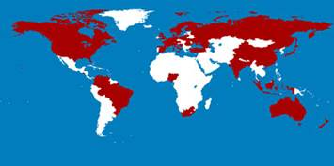
ISfTeH
Mission Statement
The ISfTeH exists to facilitate the International dissemination of knowledge and experience in Telemedicine and eHealth and to provide access to recognized experts in the field worldwide!
ISfTeH is the International representative body of
National and other Associations, Institutions, Corporations, Individuals
In Partnership with WHO, UNOOSA, WABT/UNESCO
Liaising with other International Associations

Slide 23
ISfTeH
Acting as:
Moderator in all aspects of healthcare
Feeder for information and projects
Coordinator between science, education and implementation
Activator of networking and development

Slide 24
ISfTeH
National members
Austria, Bangladesh, Bosnia & Herzegovina, Brazil, Canada, Croatia, Denmark, Finland, France, Georgia, Germany, India, Japan, Kosova, Malaysia, Nigeria, Poland, Russia, Switzerland, UK, Venezuela
Associative members
Brazil

Slide 25
ISfTeH
Institutional members
Australia, Belgium, China, Colombia, Denmark, Lithuania, Norway, Poland, South Africa, USA
Individual members
Australia, Austria, Belgium, Brazil, France, Hungary, India,
Indonesia, Italy, Japan, Moldova, New Zealand, Nigeria,
Romania, South Africa, Spain, Sweden, The Netherlands,
Turkey, Ukraine, United Kingdom, United States

Slide 26
ISfTeH Networking
Participation in major International Events 2005 ASEM – London
International Telemedicine Conference – Bangalore
MED-e-TEL 2005 – Luxembourg
5th SFT 2005 – Brisbane
10th ISfTeH International Conference - Sao Paulo
TeleMed & eHealth 2005 - London
2006 MED-e-TEL 2006 – Luxembourg
eHealth 2006 – Malaga
Telehealth 2006 – Banff
2nd National Conference of the TSI - New Delhi
6th SFT 2006 – Brisbane
NCeHT 2006 – Helsinki
TeleMed & eHealth 2006 – London
11th ISfTeH International Conference - Cape Town, (26-29/11/2006)
Global Health Care Expansion Congress – Dubai, (4-5/12/2006)
... + others

Slide 27
ISfTeH Networking
Supporting events organized by its members
2005 Telemed 2005 - Berlin (Germany)
10th Finnish National Conference - Lappeenranta (Finland)
Information & Telemedical Technologies - Moscow (Russia)
eHealth & eEducation - Sarajevo (Bosnia & Herzegovina)
2006 eHealth - Pune (India) International Conference & Schoool - Donetsk (Ukraine) @Health - Caracas (Venezuela) 3rd Croatian & International Congress - Hvar (Croatia) TTeC 2006 - Tromsö (Norway) PACTe - Abuja (Nigeria) Telemedycyna Kongres – Warsaw (Poland)
CTMC 2006 - Cartagena (Colombia)
Medicine TELE Dermatology - Graz (Austria)
... + others

Slide 28
Coming up in 2007
ISfTeH-supported events
ICDS 2007 - TELEMED 2007
Guadeloupe, French Caribbean (05.01. - 07.01.2007)
NICTe 2007 - Enugu, Nigeria (07.03. - 09.03.2007)
3rd International Conference “Telemedicine – Experience@Prospects” Donetsk, Ukraine (27.03. - 29.03.2007)
Med-e-Tel 2007 – Luxembourg, G.D. of Luxembourg (18.04 - 20.04.2007)
Cross-border eHealth in the Baltic Sea Region - Healthcare delivery for the patients of today and tomorrow - Stockholm, Sweden (21.05. - 22.05.2007)
Telehealth 2007, The Third IASTED International Conference on Telehealth - Montreal, Quebec, Canada (30.05 - 01.06.2007)
TTeC 07 – Tromsø, Norway (11.06. - 13.06.2007)
Telemedicine Society of India, 3rd National Conference
Chennai, India (2-4.11.2007)
and others to come

Slide 29
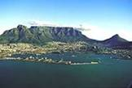
ISfTeH International Conferences
Eleven International Conferences since 1993
1993 Tromsö, Norway
1995 Rochester, U.S.A.
1997 Kobe, Japan
1999 Jerusalem, Israel
2000 Montreal, Canada
2001 Uppsala, Sweden
2002 Regensburg, Germany
2003 Tromsö, Norway
2004 Brisbane, Australia
2005 Sao Paulo, Brazil
2006 Cape Town, South Africa
Next ISfTeH International Conference (12th)
2007 Chennai, India (2-4.11)
Advanced Planning (subject to confirmation)
2008 Canada

Slide 30
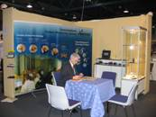
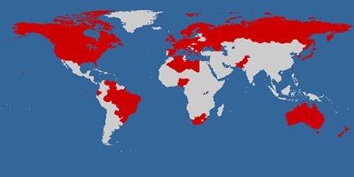
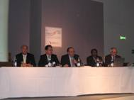
Med-e-Tel
2006
Participants from 48 countries
49 exhibitors
> 130 papers from 46 countries

Slide 31
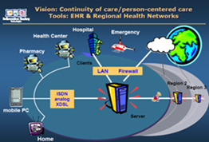
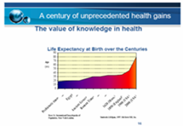
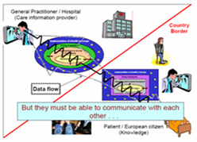
Med-e-Tel
Global eHealth Policies

Slide 32
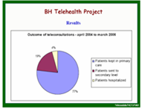
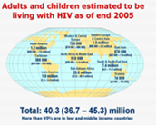
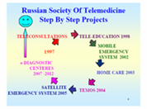
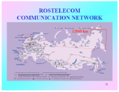
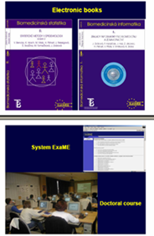
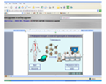
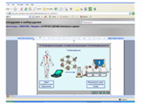
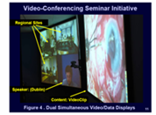
Med-e-Tel
eHealth in Developing Countries

Slide 33
Med-e-Tel
The International Educational and Networking Forum for eHealth, Telemedicine and Health ICT
18-20th April 2007 www.medetel.lu
Main topics:
eHealth/telecare for independent or assisted living in the ageing society
eHealth/telemedicine for developing countries
Medication compliance
Mobile technologies
Pro-active health monitoring
Project results and presentations
Tele-pediatrics
Standardization, interoperability
and more...
Including simultaneous meetings & workshops
Special feature workshop:
Funding Opportunities for eHealth Programs and Projects
Maximizing the Potential in Developing and Emerging Countries

Slide 34
Conclusions
eHealth/Telemedicine is truly International
The International Component is essential for further development
We must continuously learn from each other
No need to reinvent the wheel
Cooperation and coordination is necessary at all possible levels
There is no way back

Slide 35
Conclusions
In a world dominated by communication technology, communication still remains one of the most challenging issues!
Networking is vital!
Networking going faster and better to the point
Networking uncovering well kept secrets

Slide 36
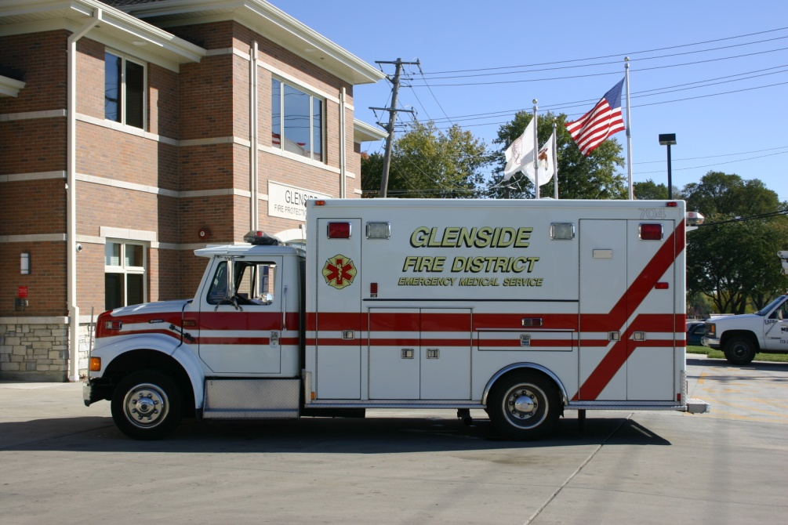
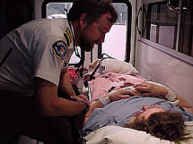
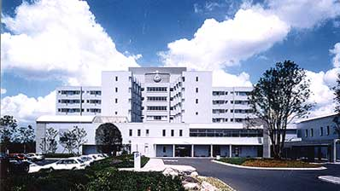
As you concentrate on your daily activities, you must yet be aware of the global frame in which all this has its place and expands
Zoom out
Zoom in

Slide 37
eHealth is truly international

Slide 38
In a time of drastic change, it is the learners who inherit the future.
The learned find themselves equipped to live in a world which no longer exists.
Eric Hoffer (1902-1983)

Slide 39
Thank you!

